Slide 1
The Processor: Datapath & Control
Simplified implementation of MIPS with:
  memory-reference: lw, sw
  arithmetic-logical: add, sub, and, or, slt
  control flow: beq, j
Generic Implementation (Fetch + Execute):
  use PC register to supply instruction address
  read the instruction from memory at PC
  read the registers specified by instruction
  use instruction opcode to decide what to do
All instructions (except one!) need to use an ALU after reading the registers. Why? E.g., memory-reference? arithmetic? control flow?

Slide 2
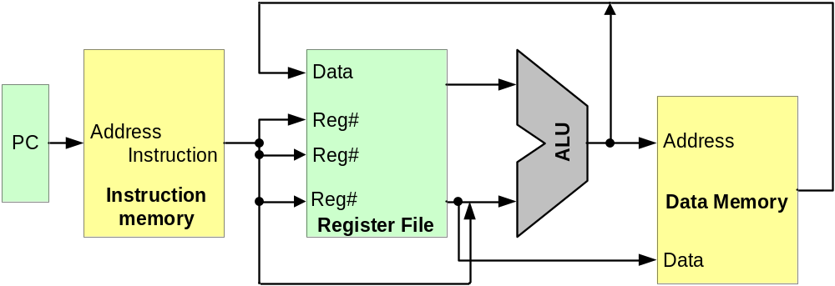
Single Cycle Implementation Details
Abstract / Simplified View:
Two types of functional units:
  elements that operate on data values (combinational)
  elements that contain state (sequential)

Slide 3
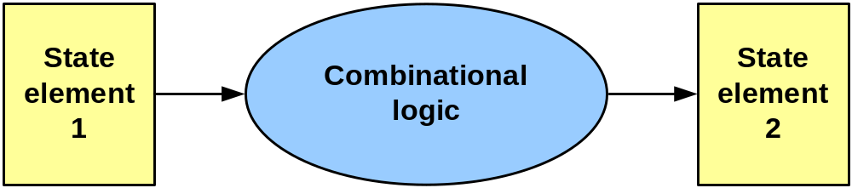
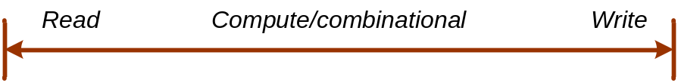
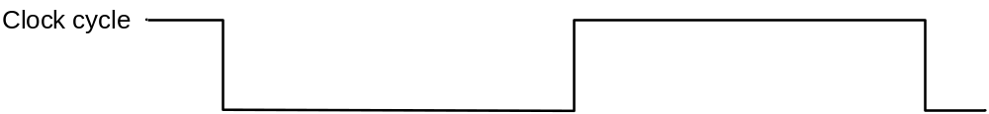
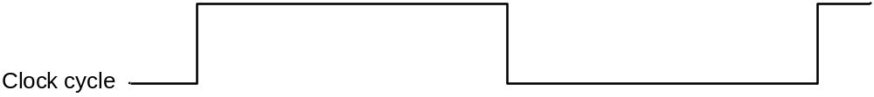
Our Implementation - Edge triggered
Typical execution:
  read contents of some state elements
  send values through some combinational logic
  write results to one or more state elements

Slide 4
A Single Cycle Implementation
Abstract / Simplified View:
“Start” of cycle: READ the IM to fetch an instr.
“Start” of cycle: READ the register file (src operands)

Slide 5
A Single Cycle Implementation
Abstract / Simplified View:
“Middle” of cycle: EXECUTE
“Middle” of cycle: EXECUTE
(lw – read memory)

Slide 6
A Single Cycle Implementation
Abstract / Simplified View:
“End” of cycle: WRITE to the register file (arithmetic and lw)
“End” of cycle: WRITE
(sw – update memory)

Slide 7
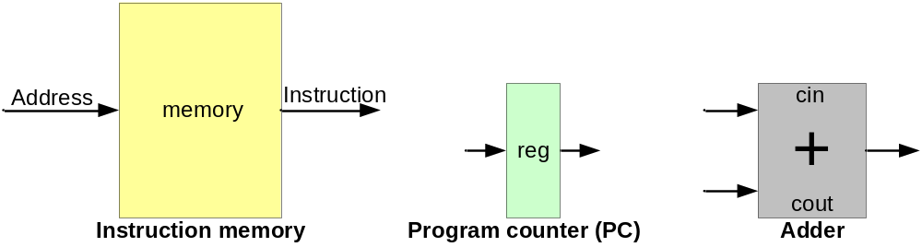
Building a Data path: Start with Fetch
Components to execute each class of instruction
Fetch components
Program counter - tracks address of instruction
Instruction memory - memory from which we fetch an instruction to execute
Adder - does increment of PC by 4, labeled as “add”

Slide 8
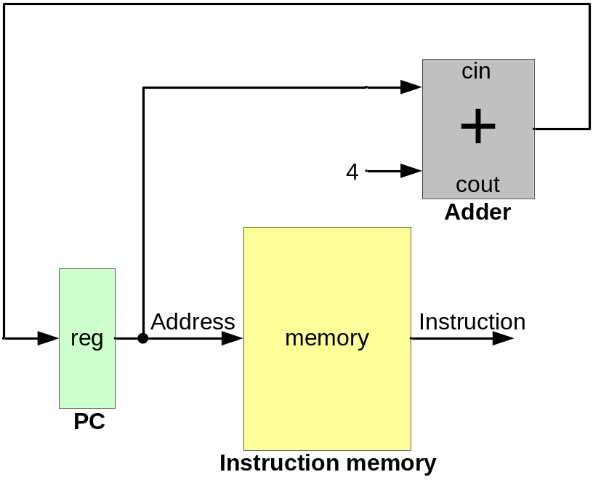
Fetching Instructions
Fetch - get instruction from memory
Increment PC by 4 after
reading instruction -
by 4 b/c an instruction
is 32 bits
Send address from PC to the
instruction memory to read the
instruction at IM[PC]
Instruction read from the
memory - send to rest of
the data path

Slide 9
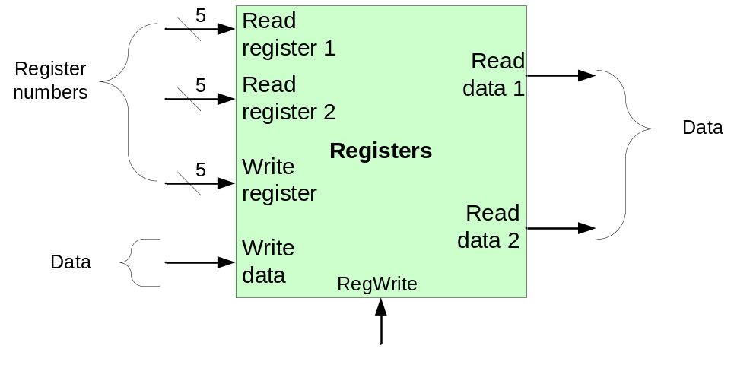
Accessing Registers
After fetching, we need to get source operands for the instruction - read the register file
Register file - collection of registers that can be read or written by specifying register number
Address of the register
to read - we need to read
two registers, so there are
two “read ports”
Data read from the
register file
For a write, we need to
send only one destination
register (number) and the
data (one “write port”)
Whether this access is a
read or a write operation

Slide 10
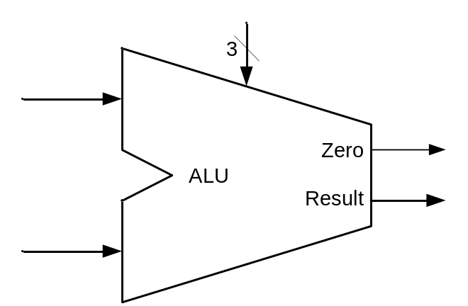
Executing the Instruction
For an arithmetic instruction, once we have the operands, we need to execute it with the ALU
What kind of operation the ALU
is going to do for an instruction
Two source operand
inputs (e.g., read from the
register file for R-type)
The result of the operation done
on the ALU
Includes “zero” detection -
whether the output is zero

Slide 11
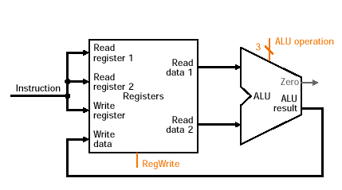
R-type Instructions (Arithmetic) Data Path
From register file and ALU, we can create the data path for arithmetic instructions
Connect read outputs from register file to ALU
Connect ALU output to register file write data input
Register numbers
come from the fixed
fields in the
instruction
Output from the ALU fed back to the register
file write data input

Slide 12
R-type Instructions (Arithmetic) Data Path
From register file and ALU, we can create the data path for arithmetic instructions
Connect read outputs from register file to ALU
Connect ALU output to register file write data input
addi $t0,$t1,$t2 RF[8] = RF[9] + RF[10]

Slide 13
R-type Instructions (Arithmetic) Data Path
From register file and ALU, we can create the data path for arithmetic instructions
Connect read outputs from register file to ALU
Connect ALU output to register file write data input
addi $t0,$t1,$t2 RF[8] = RF[9] + RF[10]

Slide 14
R-type Instructions (Arithmetic) Data Path
From register file and ALU, we can create the data path for arithmetic instructions
Connect read outputs from register file to ALU
Connect ALU output to register file write data input
addi $t0,$t1,$t2 RF[8] = RF[9] + RF[10]

Slide 15
R-type Instructions (Arithmetic) Data Path
From register file and ALU, we can create the data path for arithmetic instructions
Connect read outputs from register file to ALU
Connect ALU output to register file write data input
addi $t0,$t1,$t2 RF[8] = RF[9] + RF[10]

Slide 16
How ‘bout Load and Store?
Recall load and store:
  lw $t1,0($t2) RF[9] = MEM[signext(0) + RF[10]]
  sw $t1,12($t2) MEM[signext(12) + RF[9]] = RF[10]
Effective address - the address from which we will load or store a value
  Formed by adding offset_value + $basereg
offset_value is a 16-bit immediate (constant)
  we add on 32-bit values (using the ALU!)
  need to “sign extend” the value

Slide 17
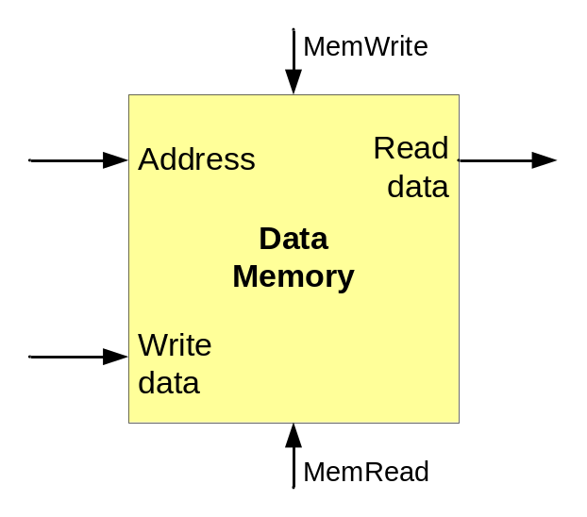
Elements for Load and Store
Data memory element - holds program data
Access to the memory is a write
operation - use address to locate
place in memory and write the
new value in that place
Address of the item to
read/write from/to memory
for a load/store
Data read from the
memory
Data value to write to
memory for a store
Access to the memory is a read
operation - use address to locate
value and send it to the output

Slide 18
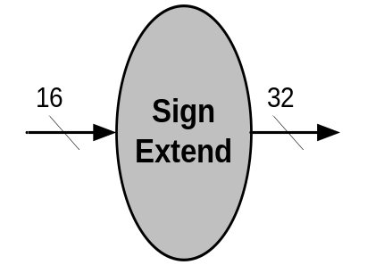
Elements for Load and Store
Sign extend - replicate the sign (msb) of the immediate offset in the top 16 bits of the 32 bit input to the adder (for forming the effective address)
16-bit input from the immediate field of
the load or store instruction
e.g.,16-bit offset -104 is 0xFF98
sign_ext(0xFF98) = 0xFFFFFF98
32-bit sign extended output (going to
the ALU for the E.A. addition)

Slide 19
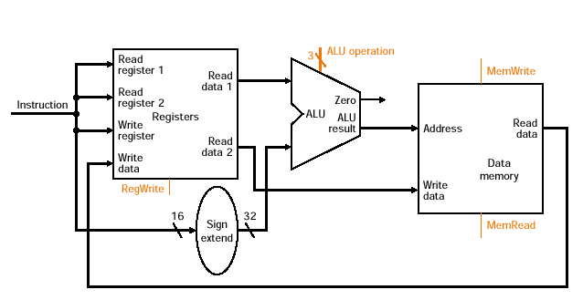
Data path for Load and Store
Combine the register file, sign extend, ALU, and the data memory
Effective address
Value of the load or
store base register
Value written
to destination
register (load)
Value to write
to memory (store)
Value read from
memory (load)
Immediate from the instruction

Slide 20
Data path for Load and Store
Combine the register file, sign extend, ALU, and the data memory
lw $t0,12($t1) RF[8] = MEM[signext(12) + RF[9]]

Slide 21
Data path for Load and Store
Combine the register file, sign extend, ALU, and the data memory
lw $t0,12($t1) RF[8] = MEM[signext(12) + RF[9]]

Slide 22
Data path for Load and Store
Combine the register file, sign extend, ALU, and the data memory
lw $t0,12($t1) RF[8] = MEM[signext(12) + RF[9]]

Slide 23
Data path for Load and Store
Combine the register file, sign extend, ALU, and the data memory
lw $t0,12($t1) RF[8] = MEM[signext(12) + RF[9]]

Slide 24
Data path for Load and Store
Combine the register file, sign extend, ALU, and the data memory
lw $t0,12($t1) RF[8] = MEM[signext(12) + RF[9]]

Slide 25
OK, now, what about branches?
Recall that the branches are:
  beq $t1,$t2,label Branch to “label” if $t1 == $t2
  bne $t1,$t2,label Branch to “label” if $t1 != $t2
So, we have:
  2 register source operands
  a 16-bit offset (PC-relative)
  ALU to do comparison (remember zero check?)
When branch taken, PC is set to (PC+4) + (offset<<2)

Slide 26
More about branches
For PC-relative branches on MIPS,
  the “base value” is actually the PC + 4
  the offset is also shifted left by 2 (word aligned)
PC + 4 value is available after we increment the PC to fetch the next instruction
Wait a minute….
  We need to compute the target address
  AND
  use the ALU to compare $t1 and $t2
What do we do????

Slide 27
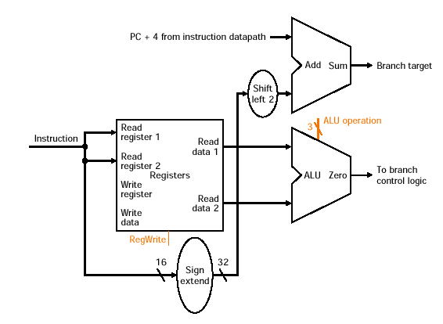
Branch Elements
A second adder - does target address calculation
Shifter - shift offset by 2
A way to set the PC to the branch target address if the branch is actually taken (“taken vs. not taken”)
PC + 4 for next instruction
Computed branch target
Should we take the branch?
Zero means two values equal
Does subtract for comparison

Slide 28
Jumps
Recall that jump is:
  j label
  label is a 26 bit value
Simply replaces PC with
  26 bit immediate shifted left by 2
  PC=PC[31..28] . (Imm26<<2)

Slide 29
Creating a Single Datapath
Data path segments for
  Fetch
  Execution
    Arithmetic operations (R-type instructions)
      Register file (read), ALU, register file (write)
    Load/store
      Register file (read), ALU (effective address), data memory (read/write), register file (write on load)
    Branches
      Register file (read), ALU (comparison), Adder (branch target address), PC (update)
Can we combine these segments so they are shared?

Slide 30
Creating a Single Datapath
Yes!
A simple datapath
  Execute instructions in a single cycle
  Hence, no datapath element used more than once by an instruction in a single cycle
    Any element needed more than once: must be duplicated
  Share datapath elements among different instruction classes

Slide 31
Sharing Datapath Elements
Share datapath element among instruction classes
  E.g., ALU between arithmetic, branch, load/store

Slide 32
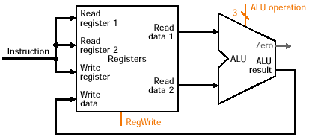
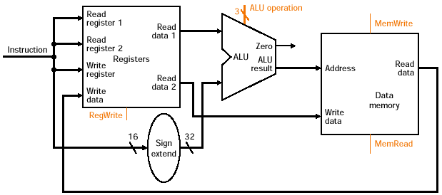
Sharing Datapath Elements
Share datapath element among instruction classes
  E.g., ALU between arithmetic, branch, load/store
Arithmetic datapath
elements
Load/store datapath
elements

Slide 33
Sharing Datapath Elements
Share datapath element among instruction classes
  E.g., ALU between arithmetic, branch, load/store
ALU is shared by
arithmetic instruction
and load/store instructions

Slide 34
Sharing Datapath Elements
Sharing may need to - wire inputs to multiple sources
  Pick among possible input sources
For arithmetic, ALU
input #2 comes from the
register file
For load/store, ALU input
#2 comes from the sign
extended element

Slide 35
Selecting Among Inputs
To select among inputs - use a multiplexor
Multiplexor
  Several inputs
  One output
  Control lines to select among different inputs
Control (C0, C1)
C0 C1 O
0 0 I0
0 1 I1
1 0 I2
1 1 I3
M
U
X
Inputs (I0-I3)
Output (O)

Slide 36
Selecting Among Inputs
To select among inputs - use a multiplexor
Multiplexor
  Several inputs
  One output
  Control lines to select among different inputs
Control (C0, C1)
C0 C1 O
0 0 I0
0 1 I1
1 0 I2
1 1 I3
M
U
X
Inputs (I0-I3)
Output (O)

Slide 37
Composing Datapaths
Let’s compose the arithmetic instruction datapath with the load/store (memory) instruction datapath

Slide 38
Composing Datapaths
Let’s compose the arithmetic instruction datapath with the load/store (memory) instruction datapath
What datapath elements
are shared?

Slide 39
Composing Datapaths
Let’s compose the arithmetic instruction datapath with the load/store (memory) instruction datapath
Two elements:
(1) Register file (RF)
(2) ALU

Slide 40
Composing Datapaths
Let’s compose the arithmetic instruction datapath with the load/store (memory) instruction datapath
What inputs need muxes?

Slide 41
Composing Datapaths
Let’s compose the arithmetic instruction datapath with the load/store (memory) instruction datapath
Two:
(1) input to ALU
(2) input to RF Write Data

Slide 42
Composing Datapaths
Let’s compose the arithmetic instruction datapath with the load/store (memory) instruction datapath
Shared
Muxed input
Not shared

Slide 43
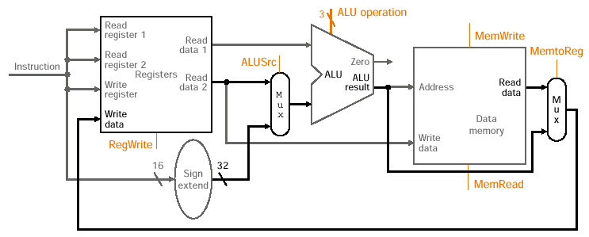
Composed Arithmetic and L/S Datapath
Two muxes -
  1. select among register or sign-extend
  2. select input to RF from ALU or data memory
Need control signals for muxes, ALU, RF, Memory

Slide 44
Composed Arithmetic and L/S Datapath
Two muxes -
  1. select among register or sign-extend
  2. select input to RF from ALU or data memory
Need control signals for muxes, ALU, RF, Memory
Activity for a R-type (arithmetic) instruction

Slide 45
Composed Arithmetic and L/S Datapath
Two muxes -
  1. select among register or sign-extend
  2. select input to RF from ALU or data memory
Need control signals for muxes, ALU, RF, Memory
Activity for a load instruction

Slide 46
Composed Arithmetic and L/S Datapath
Two muxes -
  1. select among register or sign-extend
  2. select input to RF from ALU or data memory
Need control signals for muxes, ALU, RF, Memory
Activity for a store instruction

Slide 47
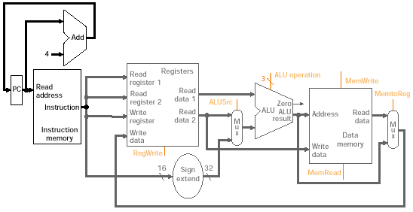
Datapath with Fetch
Composed fetch with arithmetic and load/store datapath
Separate adder for PC increment

Slide 48
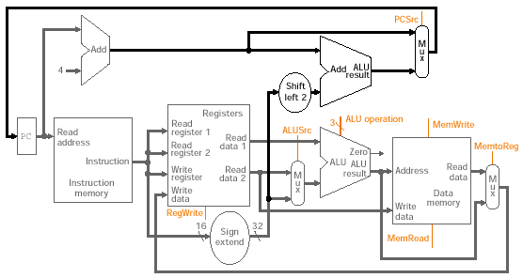
Datapath with Branches
Separate ALU for computing branch target
Shifter (by 2) for 16-bit offset constant
Mux to select among next address (PC+4) or target address from branch ALU

Slide 49
The Control Unit
Decodes instruction to determine what segments will be active in the datapath
Generates signals to
  Set muxes to correct input
  Operation code to ALU
  Read and write to register file
  Read and write to memory (load/store)
  Update of program counter (branches)
  Branch target address computation
Two parts: ALU control and Main control (muxes, etc)

Slide 50
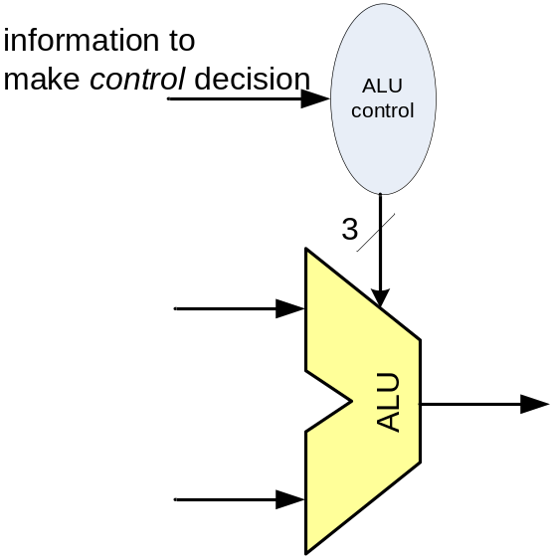
ALU Control
ALU control: specifies what operation ALU performs
  I.e., ALU operation control signals
  Eight input combinations (3 input control signals)
  Five combinations used to select operation
  ALU control input Function
  000 AND
  001 OR
  010 add
  110 subtract
  111 set on less than
Based on instruction class, one of these will be done

Slide 51
ALU Control - Selecting Operation
Class (Opcode) Operation Control
Load/store Addition (memory address) 010
Branch Subtraction (comparison) 110
Arithmetic Depends on funct field:
100000 add 010
100010 subtract 110
100100 and 000
100101 or 001
101010 set on less than 111
Generate ALU control based on opcode and funct field

Slide 52
ALU Control Unit
Small control unit associated with ALU
  Generates appropriate control signals to ALU
ALU
Control
Instruction (funct)
ALU control input
5
3
ALU operation type Input
Add for L/S 00
Sub for beq 01
From funct field 10
2
ALU operation type

Slide 53
Building the ALU Control Unit
Use truth table to determine how output will be generated based on the inputs
Operation ALUOp Funct Output
Load/Store 00 XXXXXX 010 (add)
Beq X1 XXXXXX 110 (sub)
Arithmetic 1X XX0000 010 (add)
1X XX0010 110 (sub)
1X XX0100 000 (and)
1X XX0101 001 (or)
1X XX1010 111 (slt)
From truth table, we can derive the control circuit

Slide 54
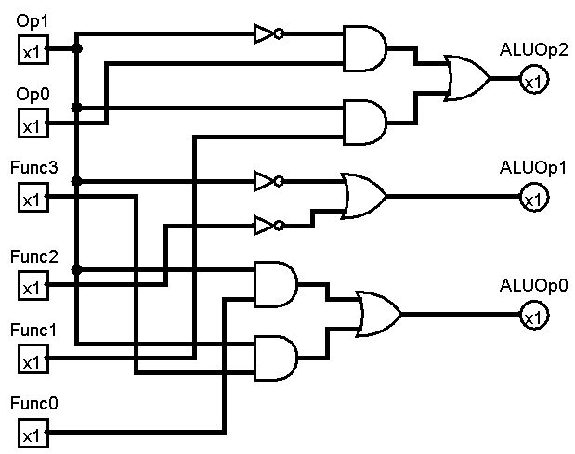
ALU Control
ALU control unit (created with Logisim)
Instr. class
Funct (instr)
ALU operation

Slide 55
Main Control Unit
Use fields from instruction to generate control
  We will “connect” the fields of the instruction to the datapath via the main control unit
R-type instruction
0
rs
rt
rd
shamt
funct
31-26
25-21
20-16
15-11
10-6
5-0
Load/Store
35 / 43
rs
rt
address
31-26
25-21
20-16
15-0
Branch (beq)
4
rs
rt
address
31-26
25-21
20-16
15-0

Slide 56
Main Control Unit
Use fields from instruction to generate control
  We will “connect” the fields of the instruction to the datapath via the main control unit
R-type instruction
0
rs
rt
rd
shamt
funct
31-26
25-21
20-16
15-11
10-6
5-0
Load/Store
35 / 43
rs
rt
address
31-26
25-21
20-16
15-0
Branch (beq)
4
rs
rt
address
31-26
25-21
20-16
15-0
Opcode is always in same position (31-26), called “Op[5-0]”

Slide 57
Main Control Unit
Use fields from instruction to generate control
  We will “connect” the fields of the instruction to the datapath via the main control unit
R-type instruction
0
rs
rt
rd
shamt
funct
31-26
25-21
20-16
15-11
10-6
5-0
Load/Store
35 / 43
rs
rt
address
31-26
25-21
20-16
15-0
Branch (beq)
4
rs
rt
address
31-26
25-21
20-16
15-0
Registers to be read are always rs and rt (always in fixed place)

Slide 58
Main Control Unit
Use fields from instruction to generate control
  We will “connect” the fields of the instruction to the datapath via the main control unit
R-type instruction
0
rs
rt
rd
shamt
funct
31-26
25-21
20-16
15-11
10-6
5-0
Load/Store
35 / 43
rs
rt
address
31-26
25-21
20-16
15-0
Branch (beq)
4
rs
rt
address
31-26
25-21
20-16
15-0
Base register for load/store is always rs in position 25-21

Slide 59
Main Control Unit
Use fields from instruction to generate control
  We will “connect” the fields of the instruction to the datapath via the main control unit
R-type instruction
0
rs
rt
rd
shamt
funct
31-26
25-21
20-16
15-11
10-6
5-0
Load/Store
35 / 43
rs
rt
address
31-26
25-21
20-16
15-0
Branch (beq)
4
rs
rt
address
31-26
25-21
20-16
15-0
16-bit offset for branch equal, load, and store always in 15-0

Slide 60
Main Control Unit
Use fields from instruction to generate control
  We will “connect” the fields of the instruction to the datapath via the main control unit
R-type instruction
0
rs
rt
rd
shamt
funct
31-26
25-21
20-16
15-11
10-6
5-0
Load/Store
35 / 43
rs
rt
address
31-26
25-21
20-16
15-0
Branch (beq)
4
rs
rt
address
31-26
25-21
20-16
15-0
Destination register in one of two places: 15-11 for arithmetic
and 20-16 for load; need multiplexor on write register address

Slide 61
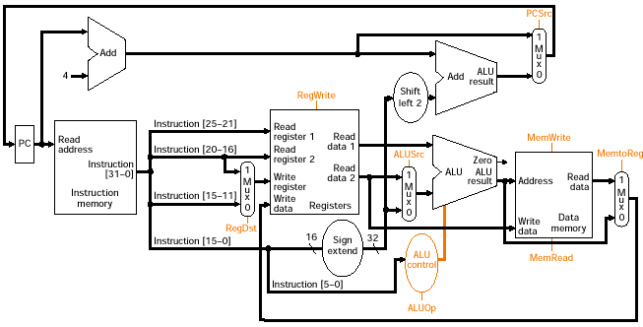
Full Datapath and Control Signals
Control includes four muxes, ALU control unit, and control to register file and data memory

Slide 62
The Control Signals
Two ALUOp signals
Seven other signals
  RegDst - which field for write register
  RegWrite - write to register file
  ALUSrc - source for second ALU input
  PCSrc - source for PC (PC + 4 or target address)
  MemRead - read input address from memory
  MemWrite - write input address/data to memory
  MemToReg - source of write register port data input
Branch control signal (set when instruction is branch)

Slide 63
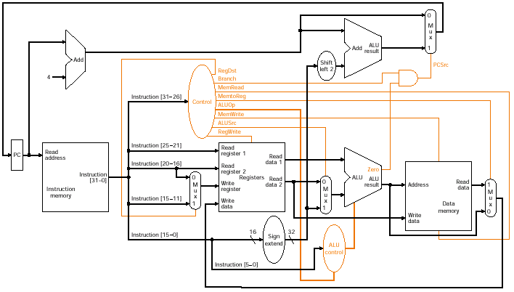
Full Datapath and Full Control

Slide 64
Operation - R-type instructions
Let’s do a add $t1,$t2,$t3

Slide 65
FETCH - add $t1,$t2,$t3
On fetch - PC, increment PC by 4, read from instruction memory

Slide 66
READ REGISTERS (t1,t2) - add $t1,$t2,$t3
Read source registers, main control unit computed all settings

Slide 67
EXECUTE - add $t1,$t2,$t3
ALU operates on data from register file, ALU control determined

Slide 68
WRITE DESTINATION (t3) - add $t1,$t2,$t3
Result from ALU is written to register file

Slide 69
Remember...Combinational Single Cycle
Distinct steps shown for clarity
Reality - information flows in those steps but it’s all combinational logic
Signals within the datapath vary and stabilize roughly in the flow of steps given
All units and paths as marked during each step are active throughout the process!

Slide 70
Load Word - lw $t1, offset($t2)
Only one source reg to read, sign extend, form address, write to
destination in different position in instruction (bits 20-16)

Slide 71
Branches - beq $t1,$t2,offset
Read and compare sources, generate zero & branch control, compute
target address, update PC if zero and branch

Slide 72
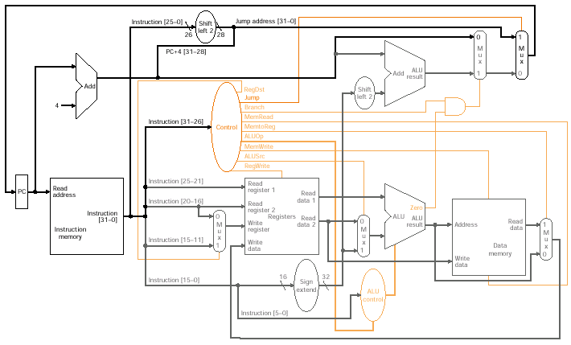
Jumps - j label
Shift address, concatenate with PC, extra mux (three possible
sources now for program counter)

Slide 73
Single vs. Multi-cycle Implementation
Single cycle design is simple
But it’s inefficient
Why?
All instructions have same clock cycle length - they all take the same amount of time regardless of what they actually do
Clock cycle determined by longest path
  Load: uses IM, RF, ALU, DM, RF in sequence
But others may be shorter
  R-type (arithmetic): use IM, RF, ALU, RF

Slide 74
Single vs. Multi-cycle Implementation
For this simple version, the multi-cycle implementation could be as much as 1.27 times faster (for a typical instruction mix)
Suppose we had floating point operations
  Floating point has very high latency
  E.g., floating-point multiply may be 16 ns vs integer add may be 2 ns
  So, clock cycle constrained by 16 ns of FP
Suppose a program doesn’t do ANY floating point?
  Performance penalty is too big to tolerate

Slide 75
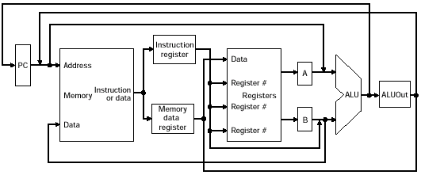
Multi-cycle Implementation
Single memory unit (I and D), single ALU
Several temporary registers (IR, MDR, A, B, ALUOut)
Temporaries hold output value of element so the output value can be used on subsequent cycle
Values needed by subsequent instruction stored in programmer visible state (memory, RF)

Slide 76
A single ALU
Single ALU must accomodate all inputs that used to go to three different ALUs in the single cycle implementation
1. Multiplexor on first input to ALU to select A register (from RF) or the PC
2. Multiplexor on second input to ALU to select from the constant 4 (PC increment), sign-extended value, shifted offset field, and RF input
Trade-off: Additional multiplexors (and time) but only a single ALU since it can be shared across cycles

Slide 77
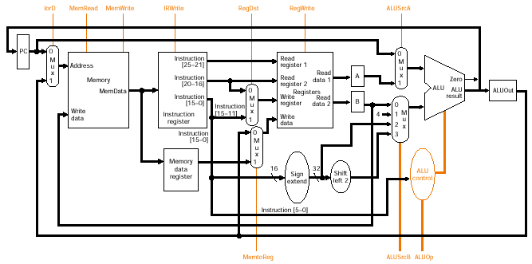
Multi-cycle Datapath with Control
Datapath with additional muxes, temporary registers, and new control signals
Most temporaries (except IR) are updated on every cycle, so no write control is required (always write)

Slide 78
Multi-cycle Steps - Instruction Fetch
Instruction fetch
  IR = Memory[PC];
  PC = PC + 4;
Operation
  Send PC to memory as the address
  Read instruction from memory
  Write instruction into IR for use on next cycle
  Increment PC by 4
    Uses ALU in this first cycle
    Set control signals to send PC and constant 4 to ALU

Slide 79
Multi-cycle Steps - Instruction Decode
Don’t yet know what instruction is
  Decode the instruction concurrently with RF read
  Optimistically read registers
  Optimistically compute branch target
  We’ll select the right answer on next cycle
Decode and Register File Read
  A = Reg[IR[25-21]];
  B = Reg[IR[20-16]];
  ALUOut = PC + (sign-extend(IR[15-0]) << 2);

Slide 80
Multi-cycle Steps - Execution
Operation varies based on instruction decode
Memory reference:
  ALUOut = A + sign-extend(IR[15-0]);
Arithmetic-logical instruction:
  ALUOut = A op B;
Branch:
  if (A == B) PC = ALUOut;
Jump:
  PC = PC[31-28] || (IR[25-0] << 2)

Slide 81
Multi-cycle Steps - Memory / Completion
Load/store accesses memory or arithmetic writes result to the register file
Memory reference:
  MDR = Memory[ALUOut]; (load)
  or
  Memory[ALUOut] = B; (store)
Arithmetic-logical instruction:
  Reg[IR[15-11]] = ALUOut;

Slide 82
Multi-cycle Steps - Read completion
Finish a memory read by writing read value into the register file
Load operation:
  Reg[IR[20-16]] = MDR;

Slide 83
Multi-cycle Steps
Instructions always do the first two steps
Branch can finish in the third step
Arithmetic-logical can finish in the fourth step
Stores can finish in the fourth step
Loads finish in the fifth step
Instruction Number of cycles
Branch / Jump 3
Arithmetic-logical 4
Stores 4
Loads 5

Slide 84
Multi-cycle Datapath with Control

Slide 85
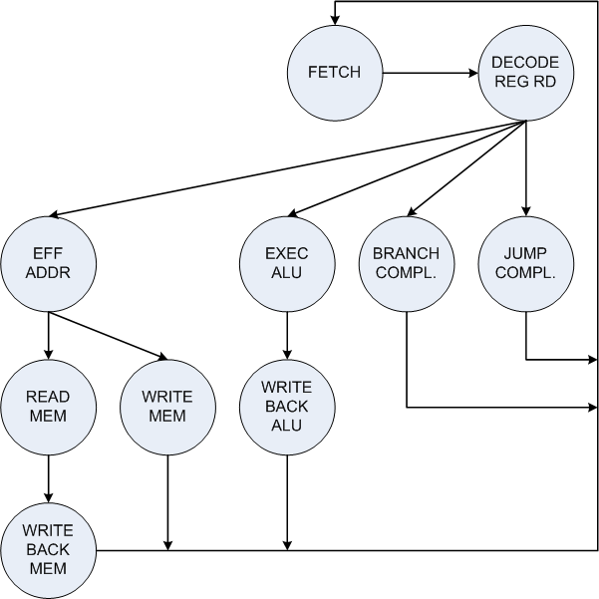
Multi-cycle Control

Slide 86
Multi-cycle Control
How are the control signals set in each state?
What are the transitions between states? (i.e., what state is next?)
Control signals
  IorD, MemRead, MemWrite, IRWrite, RegDst
  MemtoReg, RegWrite, ALUSrcA
  ALUSrcB, ALUOp
  PCWrite
Transitions from Decode based on Opcode
Transitions from Eff. Addr. happen on load/store

Slide 87
Multi-cycle Control
What are the control signals in each state for instrs:
  Arithmetic
  Load
  Store
  Branch
  Jump

